Slide 1

Summarizing CNN Articles Using Llama
DATASCI266 – NATURAL LANGUAGE PROCESSING
ADITYA KUMAR, IRINA LEE, MATTHEW SHULL

Slide 2
Overview
PROBLEM STATEMENT
MOTIVATION
Abstractive summaries can be generated using LLaMA models, but their evaluation against human-generated summaries remains limited, focusing primarily on lexical similarity rather than deeper semantic alignment.
This project evaluates the ability of a pre-trained LLaMA model to summarize news articles and assesses its effectiveness using ROUGE metrics and GPT-4o-mini semantic similarity scoring. The findings aim to demonstrate the practicality of zero-shot pre-trained models for real-world summarization tasks.

Slide 3
Dataset & Methodology
Dataset:
CNN & Daily Mail news dataset: A collection of news articles paired with human-generated abstractive summaries.
Size: 287113 rows by 3 columns
Articles cover diverse topics, making the dataset a robust test for generalization.
Subset of 500 articles sampled for computational feasibility (runtime: ~3 hours per batch).
Summarization Process:
Preprocessing: Cleaned text by removing noise and standardizing structure while preserving grammar and punctuation.
Model Configuration:
Used the Meta-LLaMA-3.1-8B-Instruct model with quantization for efficiency.
Designed structured prompts to guide the model toward concise 4–5 line summaries.
Evaluation Framework:
ROUGE: Measures lexical overlap between generated and reference summaries.
STS with GPT4o-mini: Evaluates semantic alignment, rating similarity on a scale of 1–5.

Slide 4
Challenges & Limitations
Computational Constraints:
Limited dataset to 500 samples due to the high computational demand of running the LLaMA model (~2–3 hours per batch).
Scalability to larger datasets remains a challenge without additional resources.
Model-Specific Limitations:
Pre-fine-tuned model occasionally produced generalized summaries lacking domain-specific nuances.
Performance could improve with task-specific fine-tuning.
GPT-4 Evaluation Biases:
Variability in scores due to inherent subjectivity and dependence on well-crafted prompts.
Reliance on GPT-4 introduces external costs and potential biases from the evaluation model itself.
Computational Constraints:
Limited dataset to 4 batches of 500 (2000 total) samples due to the high computational demand of running the LLaMA model (~3 hours per batch)
Scalability to larger datasets remains a challenge without additional resources
Articles and summaries were not cleaned or standardized for quick analysis
Model-Specific Limitations:
Pre-trained LLaMA model produces generalized summaries but lack domain-specific nuances
Performance could improve with task-specific fine-tuning
GPT-4 Evaluation Biases:
Variability in scores due to inherent subjectivity and dependence on well-crafted prompts
Reliance on GPT-4 introduces external costs and potential biases from the evaluation model itself
Computational Cost:
GPT-4o model cost per run ~ $100 per batch
GPT-4o-mini was more cost efficient and provides similar results to GPT-4o

Slide 5
Methodology
Computational Constraints:
Limited dataset to 500 samples due to the high computational demand of running the LLaMA model (~2–3 hours per batch).
Scalability to larger datasets remains a challenge without additional resources.
Model-Specific Limitations:
Pre-fine-tuned model occasionally produced generalized summaries lacking domain-specific nuances.
Performance could improve with task-specific fine-tuning.
GPT-4 Evaluation Biases:
Variability in scores due to inherent subjectivity and dependence on well-crafted prompts.
Reliance on GPT-4 introduces external costs and potential biases from the evaluation model itself.
Summarizer Model:
Meta-Llama-3.1-8B-Instruct
Instructed the model to generate summaries guided by a specified prompt
Model Outputs: Abstractive Summaries
Semantic Scoring Model:
Developed a GPT-4o-mini model to semantically score the generated and reference summaries by feeding a well-designed judging criteria
The judging categories and weights:
Coverage of Key Ideas (30%)
Coherence and Logical Flow (20%)
Faithfulness to the Reference (30%)
Paraphrasing and Rewording (15%)
Language and Style (5%)
Model Outputs: STS Score and category scores with feedback

Slide 6
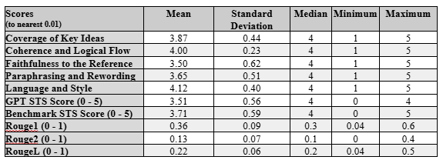
Results & Analysis
ROUGE Scores:
ROUGE-1: High unigram overlap, reflecting strong content alignment.
ROUGE-2: Strong bigram overlap, indicating coherence and fluency.
ROUGE-L: Effective sentence-level structural alignment.
STS Scores:
Most summaries scored 4 (very similar) or 5 (identical in meaning) by GPT-4o-mini.
Demonstrates that the model captures key semantic elements even without fine-tuning.
Comparison with Literature:
Fine-tuned models achieve slightly better domain-specific performance but at higher computational costs.
The pre-trained LLaMA model provides competitive results with minimal setup, highlighting its practical utility.

Slide 7
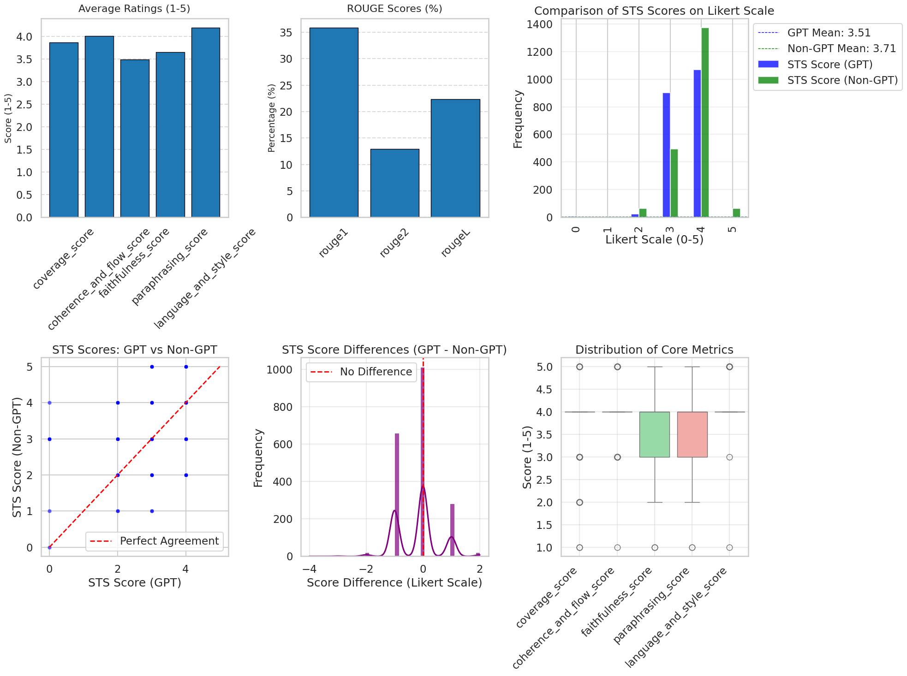

Slide 8
Conclusions
Next Steps
Computational Constraints:
Limited dataset to 500 samples due to the high computational demand of running the LLaMA model (~2–3 hours per batch).
Scalability to larger datasets remains a challenge without additional resources.
Model-Specific Limitations:
Pre-fine-tuned model occasionally produced generalized summaries lacking domain-specific nuances.
Performance could improve with task-specific fine-tuning.
GPT-4 Evaluation Biases:
Variability in scores due to inherent subjectivity and dependence on well-crafted prompts.
Reliance on GPT-4 introduces external costs and potential biases from the evaluation model itself.
The pre-trained Meta-LLaMA-3.1-8B-Instruct model demonstrated strong summarization performance with minimal computational resources.
High ROUGE and STS scores validate the model's capability to generate coherent, semantically accurate summaries
LLaMA summaries show a strong coverage of information on the articles but do not follow the same paraphrasing and information faithfulness as the reference summaries
Utilize GPT model to score the human developed reference summaries
Perform few-shot fine-tuning on the LLaMA model prior to summarization
Create metadata information for each article to determine the cause for low/high STS scores

Slide 9
References
Fabian Retkowski. (2023). The current state of summarization. Retrieved from https://arxiv.org/pdf/2406.06608
Hou, S., Huang, X., Fei, C., et al. (2021). A survey of text summarization approaches based on deep learning. Journal of Computer Science and Technology, 36(3), 633-663. https://doi.org/10.1007/s11390-020-0207-x
Lin, C.-Y. (2004). ROUGE: A package for automatic evaluation of summaries.
Liu, H., Gao, J., Zhang, X., & Sun, M. (2023). G-Eval: A GPT-based framework for evaluating text summarization models. arXiv preprint. Retrieved from https://arxiv.org/abs/2303.12796
Nallapati, R., Zhou, B., Gulcehre, C., et al. (2016). Abstractive text summarization using sequence-to-sequence RNNs and beyond. arXiv preprint. Retrieved from https://arxiv.org/abs/1602.06023
Paulus, R., Xiong, C., & Socher, R. (2017). A deep reinforced model for abstractive summarization. arXiv preprint. Retrieved from https://arxiv.org/abs/1705.04304
Rehman, T., Ahmed, Z., & Khan, F. (2023). Evaluating pre-trained models for abstractive text summarization: Challenges and opportunities. arXiv preprint. Retrieved from https://arxiv.org/abs/2303.16634
Yadav, D., Gautam, S., Sharma, K., et al. (2022). Feature-based automatic text summarization methods: A comprehensive state-of-the-art survey. IEEE Access. https://doi.org/10.1109/access.2022.3231016
Zhang, Z., Liu, P., & Wang, Y. (2023). A review of language model scaling for abstractive summarization. arXiv preprint. Retrieved from https://arxiv.org/abs/2406.06608

Slide 10
THANK YOU

